Slide 1

Final Year project 2021
Centralized Database for universities
GOVERNMENT DATABASE
University Database
UIP Database

Slide 2

Module 1: Data Scraping

Slide 3
Data Scraping
Government & University Website
Beautiful Soup
Selenium
ParseHub

Slide 4

Module 2: Construct Database

Slide 5
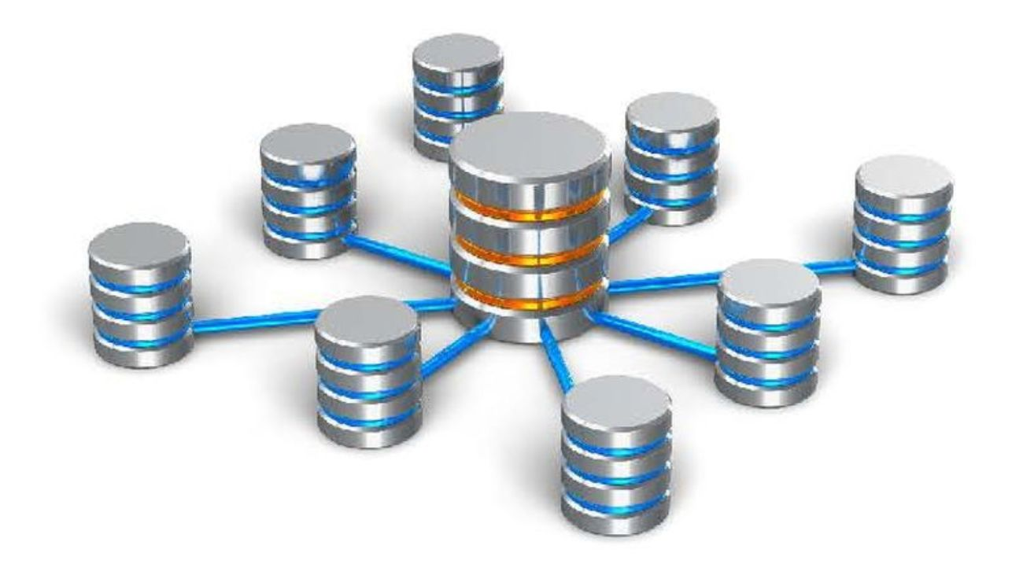
Contruct database
Gather all Data into one
UIP Projects Module

Slide 6

Module 3: DATa Cleaning

Slide 7
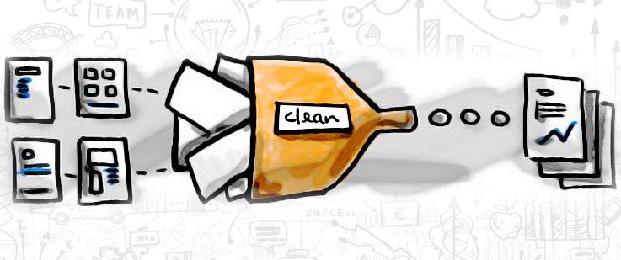
Data cleaning
Remove useless symbol
Better analysis environment

Slide 8

Module 4: Sort & filter Function

Slide 9
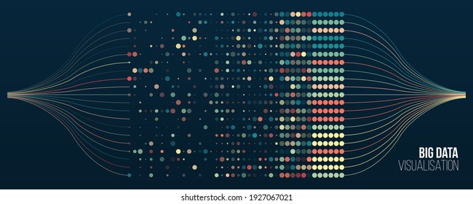
Sort & Filter Function
Sort Function
Filter Function

Slide 10

Module 5: UI Website

Slide 11

UI WEBSite
HTML5, CSS, JavaScript
User-friendly Interface

Slide 12


